Slide 1
In the name of God STAYING HEALTHY
DORSA SAFAI – NIKA KARIMPOUR – SETAYESH MORADI
Farzanegan 5 international projects

Slide 2
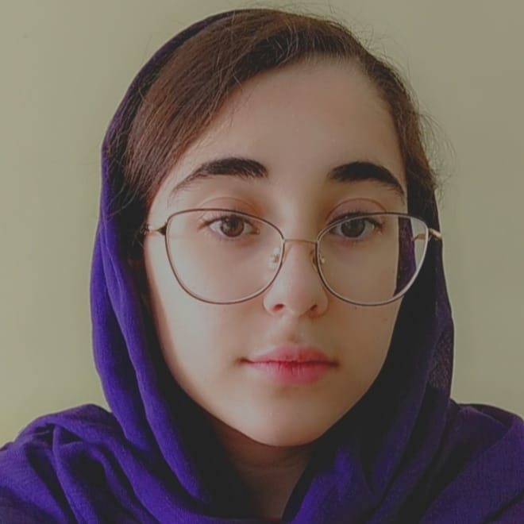
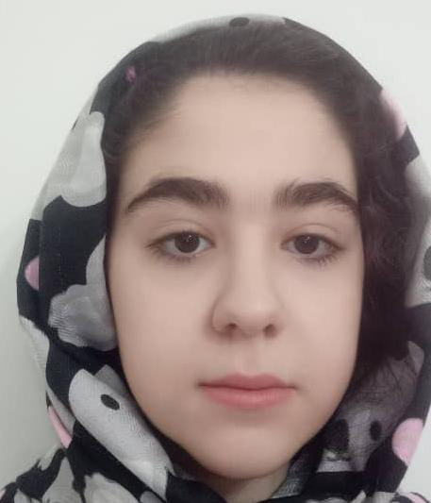
Teammates
We are students of Farzanegan 5 school, 8th grade. We are 14 years old and we are very interested in participating in international projects and we want to improve our English. We are also interested in communicating with students from other countries.
Dorsa Safai
Nika Karimpour
Setayesh Moradi

Slide 3
Thanks a lot to our dear teacher ,Mrs.Abedi, for guiding us through this project.
iEARN is a non-profit organization made up of over 30,000 schools and youth organizations in more than 140 countries. Our project is one of the projects of this organization .

Slide 4
We choose this project to develop a healthy life style and to keep our mind and body performing at their best. We are learning what a healthy diet is and exploring relationship between diet and health.
healthy body is not just about being fit we need to develop a healthy mental and spiritual attitude for our physical well being.

Slide 5
We have chosen some healthy meals and dishes to recommend
Sabzi Polo
Ashe Reshte
Jojeh Kabab
Sezar Salata (Salad)

Slide 6
Sabzi Polo
main ingredient(amount in 100 g)
Energy (calories) 203 kcal
Carbohydrates 23.15 g
Protein 10.29 g
Fat 7.49
Sugar 0.41 g
Sabzi polo is a classic Nowruz (Iranian New Year) dish of rice and chopped herbs and vegetables, usually served with fish. In Persian, sabzi refers to herbs or vegetables, and polo is a style of cooked rice.
We recommend this food to people who have a normal diet and eating this food provides the some vitamins from vegetables and carbohydrates from rice

Slide 7
Ashe Reshte
Energy 115 kcal
Carbohydrates 13.87g
Protein 10.6g
Fat 2.19g
Sugar 1g
Ashe Reshte is one of the most famous Iranian dishes. It is a kind of soup often eaten with curd. Ingredients for this soup include beans, herbs and noodles.
It is suitable for people who are vegans and has enough protein (because of the beans it has). We also recommend it to people who want to have a light meal

Slide 8
Jojeh Kabab
The calories of jojeh kebab with bones are 239 calories per 100 grams. But boneless grilled chicken with chicken breast has 165 calories per 100 grams and is less fat.
Jojeh kebab is one of the most popular Iranian dishes that is eaten and served in special gatherings, picnics and trips. It's a kind of chicken kebab.
This food is high in protein and also low in fat, so we recommend it to people who are athletes or want protein in their diet.

Slide 9
Sezar Salata
Per 100 grams: 542 kcal Carbohydrates 3.30 g Protein 2.17 g Fat 57.85 grams 2.81 grams of sugar
Sezar salad is one of the most famous dishes in the world, which is known for its lightness and simplicity. Its ingredients are usually lettuce, chicken and bread.
Sezar salad is suitable for people with a balanced diet and for those who have a strict diet, it is a food with very low fat and sugar and equivalent calories.

Slide 10
Thanks for your attention!
Winter 2022

